Slide 1


Django Workshop 2022
Rishabh Rathi
Aditya Sharma

Slide 2
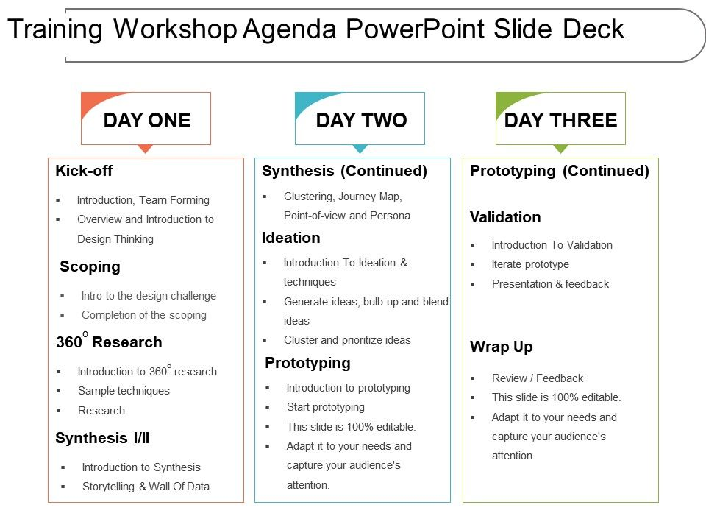
Agenda
Introduction to Backend
Complete Python Bootcamp course
Introduction to Django
Installing Django
Project Intro
Client - Server Model
Django's folder structure
Django Models
Django Templates
Creating home view
Creating Django Forms
Creating Django Models
Creating the url-shortener app
Creating analytics page
Creating Preview Page
Deploy on Internet

Slide 3
What you will learn?
Installation
Templates
Static files
URL Mapping
Models
Admin Panel
Forms

Slide 4
Today's Agenda
Introduction
What is backend?
Complete Python Bootcamp course
Introduction to Django
Installing Django

Slide 5
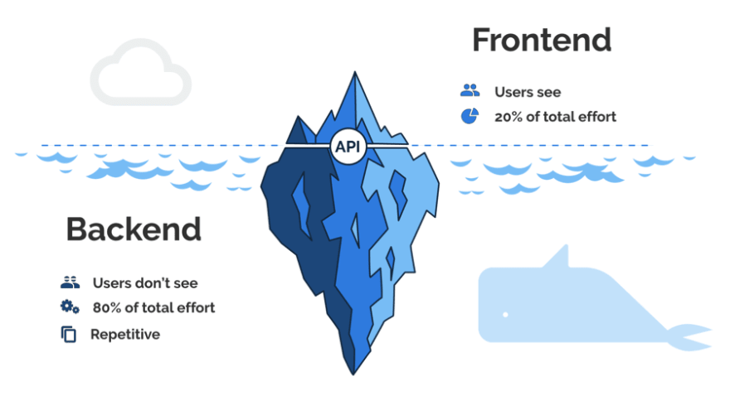
Frontend vs Backend
Languages
PHP
C++
Python
Java
Node.js
Languages
HTML
CSS
JavaScript
Frameworks
Express
Django
Rails
Laravel
Spring
Frameworks
AngularJS
React.js
jQuery
SASS

Slide 6
What is a Back-end?
When we talk about web development, we can usually think in terms of clients and servers.
Users interact directly with clients such as websites or mobile apps. These clients then send requests over the network to servers, which are programs that are running on some machine somewhere in the world.
Back-end Development refers to the server-side development. It is the term used for the behind-the-scenes activities that happen when performing any action on a website.

Slide 7
Best Back-end Frameworks
Framework | Programming Language | Famous Use Cases
Django | Python | Instagram, Pinterest, Coursera
Ruby on Rails | Ruby | ZendDesk, Shopify, GitHub
ExpressJS | NodeJS | MySpace, Storify
Flask | Python | Red Hat, Reddit
Asp .NET | C# | Microsoft, Godaddy, Ancestry
Spring Boot | Java | Trivago

Slide 8
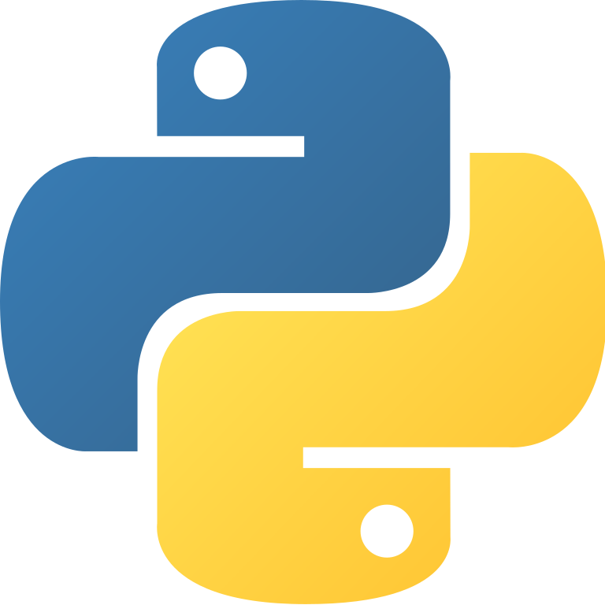
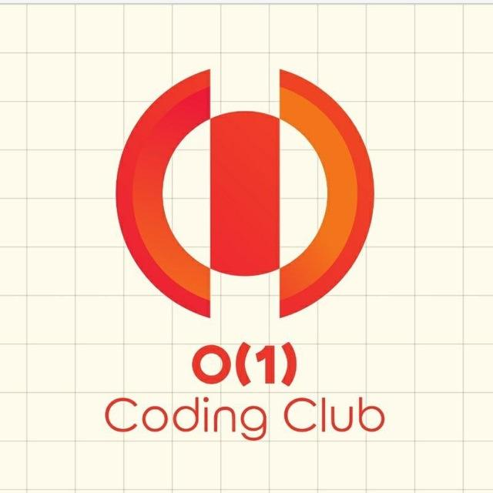

Introduction to Python
Speaker: Aditya Sharma

Slide 9
Overview
Introduction
Installing & Running Python
Python Programming
  Data types
  Sequences types: Lists, Tuples, Sets, Dictionary
  Control flows
  Functions
  Modules & packages
  Handling exceptions

Slide 10
Brief History of Python
Python is a popular programming language.
Invented in the Netherlands, early 90s by Guido van Rossum
Open sourced from the beginning
Considered a scripting language, but is much more
Used by Google from the beginning
Increasingly popular

Slide 11
Why Python?
Python works on different platforms (Windows, Mac, Linux, Raspberry Pi, etc).
Python has a simple syntax similar to the English language.
Python has syntax that allows developers to write programs with fewer lines than some other programming languages.
Python runs on an interpreter system, meaning that code can be executed as soon as it is written. This means that prototyping can be very quick.
Python can be treated in a procedural way, an object-oriented way or a functional way.

Slide 12
Python Syntax
Python was designed for readability, and has some similarities to the English language with influence from mathematics.
Python uses new lines to complete a command, as opposed to other programming languages which often use semicolons or parentheses.
Python relies on indentation, using whitespace, to define scope; such as the scope of loops, functions and classes. Other programming languages often use curly-brackets for this purpose.

Slide 13
File naming conventions
Python files end with the suffix .py
Comments
Single Line comment - Start with # and go to end of line
Multi-line comments - Start and end with """ (triple quotes)

Slide 14

Running Python

Slide 15
IDLE
IDLE is an Integrated Development Environment for Python, typically used on Windows
Multi-window text editor with syntax highlighting, auto-completion, smart indent and other.
Python shell with syntax highlighting.

Slide 16
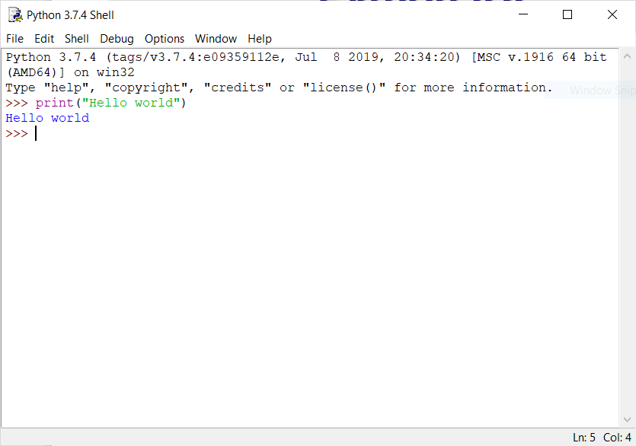
Python IDE

Slide 17
Running Interactively on UNIX
Python prompts with ‘>>>’
To exit Python (not Idle):
  In Unix, type CONTROL-D
  In Windows, type CONTROL-Z + <Enter>
  Evaluate exit()

Slide 18
Python Scripts
When you call a python program from the command line the interpreter evaluates each expression in the file
Familiar mechanisms are used to provide command line arguments and/or redirect input and output
Python also has mechanisms to allow a python program to act both as a script and as a module to be imported and used by another python program

Slide 19

Python Data Types

Slide 20
Built-in Data Types
Type | Data types
Numeric Types | int, float
Text Type | str
Sequence Types | list, tuple
Mapping Type | dict
Set Types | set
Boolean Type | bool
Getting the Data Type
You can get the data type of any object by using the type( ) function.

Slide 21
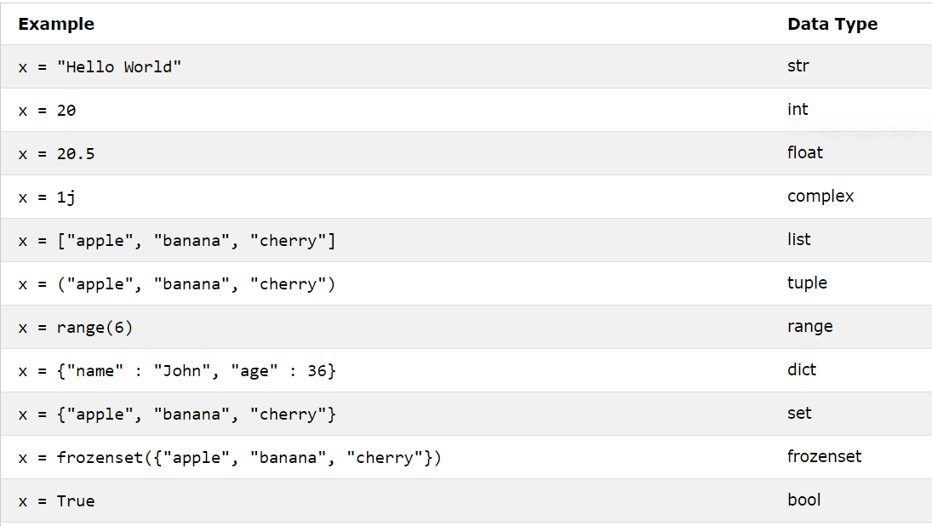
Setting the Data Type

Slide 22
Type Conversion
int( ) - constructs an integer number from an integer literal, a float literal (by rounding down to the previous whole number), or a string literal (providing the string represents a whole number)
float( ) - constructs a float number from an integer literal, a float literal or a string literal (providing the string represents a float or an integer)
str( ) - constructs a string from a wide variety of data types, including strings, integer literals and float literals

Slide 23
Basic Datatypes
Integers (default for numbers)
  z = 5 / 2 # Answer 2, integer division
Floats
  x = 3.456
Strings
  Can use “ ” or ‘ ’ to specify. (“abc” == ‘abc’)
  Unmatched can occur within the string: “matt’s”
  Use triple double-quotes for multi-line strings or strings than contain both ‘ and “ inside of them:
  “““a‘b“c”””

Slide 24
Type Conversion
int( ) - Example
x = int(1) # x will be 1
y = int(2.8) # y will be 2
z = int("3") # z will be 3
float( ) - Example
  x = float(1) # x will be 1.0
  y = float(2.8) # y will be 2.8
  z = float("3") # z will be 3.0
  w = float("4.2") # w will be 4.2
str( ) - Example
x = str("s1") # x will be 's1'
y = str(2) # y will be '2'
z = str(3.0) # z will be '3.0'

Slide 25
Strings
Strings are Arrays
  a = "Hello, World!"
  print(a[1]) # Output - 'e'
Looping Through a String
  for x in a:
  print(x)
String Length
  print(len(a))

Slide 26
Strings
Check String - To check if a certain phrase or character is present in a string, we can use the keyword in.
  txt = "The best things in life are free!"
  print("free" in txt)
Check if NOT - To check if a certain phrase or character is NOT present in a string, we can use the keyword not in.
  txt = "The best things in life are free!"
  print("expensive" not in txt)

Slide 27
Strings
"hello"+"world" "helloworld" # concatenation
"hello"*3 "hellohellohello" # repetition
"hello"[0] "h" # indexing
"hello"[-1] "o" # (from end)
"hello"[1:4] "ell" # slicing
len("hello") 5 # size
"hello" < "jello" True # comparison
"e" in "hello" True # search

Slide 28
Methods in string
“hello”.replace('l', 'm') 'hemmo' # replace
“a,b,c”.split(',') ['a', 'b', 'c'] # split
“-”.join(['a', 'b', 'c']) 'a-b-c' # join
“abcd”.upper() 'ABCD' # upper
“ABCD”.lower() 'abcd' # lower
“abcD”.capitalize() 'Abcd' # capitalize
“hello”.count('l') 2 # count
“Rishabh”.find('a') 4 # find
“Rishabh”.find('z') -1 # find
“Rishabh”.index('a') 2 # index
“Rishabh”.index('z') ValueError: substring not found

Slide 29
Boolean Values
You can evaluate any expression in Python, and get one of two answers, True or False.
  print(10 > 9) # True
  print(10 == 9) # False
  print(10 < 9) # False
Most Values are True
  Any string is True, except empty strings.
  Any number is True, except 0.
  Any list, tuple, set, and dictionary are True, except empty ones.

Slide 30
Python Operators
Python divides the operators in the following groups:
Arithmetic operators - +, -, *, /, **, //
Assignment operators - =, +=, -=, *=, /= (no ++ or --)
Comparison operators - ==, !=, >, >=, <, <=
Logical operators - and, or, not
Identity operators - is, is not
Membership operators - in, not in
Bitwise operators - &, |, ^, ~, <<, >>

Slide 31
A Code Sample (in IDLE)
x = 34 - 23 # A comment.
y = “Hello” # Another one.
z = 3.45
if z == 3.45 or y == “Hello”:
x = x + 1
y = y + “ World” # String concat.
print (x)
print (y)

Slide 32
Enough to Understand the Code
Indentation matters to code meaning
  Block structure indicated by indentation
First assignment to a variable creates it
  Variable types don’t need to be declared.
  Python figures out the variable types on its own.
Assignment is = and comparison is ==
For numbers + - * / % are as expected
  Special use of + for string concatenation and % for string formatting (as in C’s printf)
Logical operators are words (and, or, not) not symbols
The basic printing command is print()
Input command is input()

Slide 33
Whitespace
Whitespace is meaningful in Python: especially indentation and placement of newlines
Use a newline to end a line of code
  Use \ when must go to next line prematurely
No braces {} to mark blocks of code, use consistent indentation instead
    First line with less indentation is outside of the block
    First line with more indentation starts a nested block
  Colons start of a new block in many constructs, e.g. function definitions, then clauses

Slide 34
Assignment
Binding a variable in Python means setting a name to hold a reference to some object
  Assignment creates references, not copies
Names in Python do not have an intrinsic type, objects have types
  Python determines the type of the reference automatically based on what data is assigned to it
You create a name the first time it appears on the left side of an assignment expression:
x = 3
A reference is deleted via garbage collection after any names bound to it have passed out of scope

Slide 35
Naming Rules
Names are case sensitive and cannot start with a number. They can contain letters, numbers, and underscores.
  var Var _var _2_var_ var_2 VaR
There are some reserved words:
  and, assert, break, class, continue, def, del, elif, else, except, exec, finally, for, from, global, if, import, in, is, lambda, not, or, pass, print, raise, return, try, while

Slide 36
Assignment
You can assign to multiple names at the same time
  >>> x, y = 2, 3
  >>> x
  2
  >>> y
  3
This makes it easy to swap values
  >>> x, y = y, x
Assignments can be chained
  >>> a = b = x = 2

Slide 37
Accessing Non-Existent Name
Accessing a name before it’s been properly created (by placing it on the left side of an assignment), raises an error
>>> y
Traceback (most recent call last):
File "<pyshell#16>", line 1, in -toplevel-
y
NameError: name ‘y' is not defined
>>> y = 3
>>> y
3

Slide 38

Sequence types:
List, Tuple, Set and Dictionary

Slide 39
Python Lists
Used to store collections of data
Lists are created using square brackets
Mutable ordered sequence of items of mixed type
List items are ordered, changeable, and allow duplicate values.
List items are indexed, the first item has index [0], the second item has index [1] etc.
A list can contain different data types
Example - [1, 2, ‘john’, (‘up’, ‘down’)]

Slide 40
List Operations
>>> a = list(range(5)) # [0,1,2,3,4]
>>> a.append(5) # [0,1,2,3,4,5]
>>> a.pop() # [0,1,2,3,4]
5
>>> a.remove(2) # [0,1,3,4]
>>> a.insert(0, “hello”) # [“hello”,0,1,3,4]
>>> a.pop(0) # [0,1,3,4]
”hello”
>>> a.reverse() # [4,3,1,0]
>>> a.sort() # [0,1,3,4]
>>> b = a.copy() # [0,1,3,4]

Slide 41
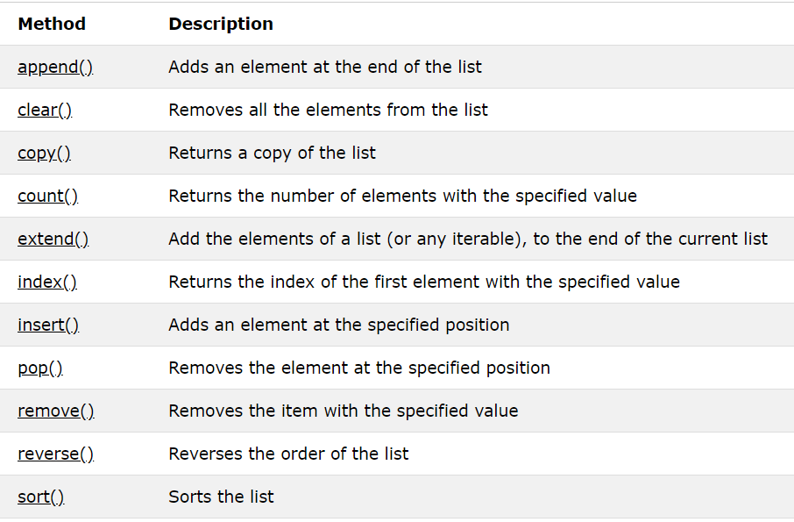
List Operations

Slide 42
Nested List
List in a list
E.g.,
  >>> s = [1,2,3]
  >>> t = [‘begin’, s, ‘end’]
  >>> t
  [‘begin’, [1, 2, 3], ‘end’]
  >>> t[1][1]
  2

Slide 43
Reference Semantics
Assignment manipulates references
  x = y does not make a copy of y
  x = y makes x reference the object y references
Very useful; but beware!
Example:
    >>> a = [1, 2, 3]
    >>> b = a
    >>> a.append(4)
    >>> print b
    [1, 2, 3, 4]

Slide 44
Changing a Shared List
a
1
2
3
a = [1, 2, 3]
a
1
2
3
b = a
b
a
1
2
3
a.append(4)
4
b

Slide 45
Changing an Integer
a
1
a = 1
a
1
b = a
b
new int object created
by add operator (1+1)
a
2
a = a+1
old reference deleted
by assignment (a=...)
1
b

Slide 46
Python Tuples
Tuples are used to store multiple items in a single variable.
A tuple is a collection which is ordered and unchangeable.
Tuples are written with round brackets.
Tuple allows duplicate values.
Tuple items are indexed, the first item has index [0], the second item has index [1] etc.
Example - ("apple", "banana", "cherry")

Slide 47
The + Operator
The + operator produces a new tuple, list, or string whose value is the concatenation of its arguments.
>>> (1, 2, 3) + (4, 5, 6)
(1, 2, 3, 4, 5, 6)
>>> [1, 2, 3] + [4, 5, 6]
[1, 2, 3, 4, 5, 6]
>>> “Hello” + “ ” + “World”
‘Hello World’

Slide 48
The * Operator
The * operator produces a new tuple, list, or string that “repeats” the original content.
>>> (1, 2, 3) * 3
(1, 2, 3, 1, 2, 3, 1, 2, 3)
>>> [1, 2, 3] * 3
[1, 2, 3, 1, 2, 3, 1, 2, 3]
>>> “Hello” * 3
‘HelloHelloHello’

Slide 49
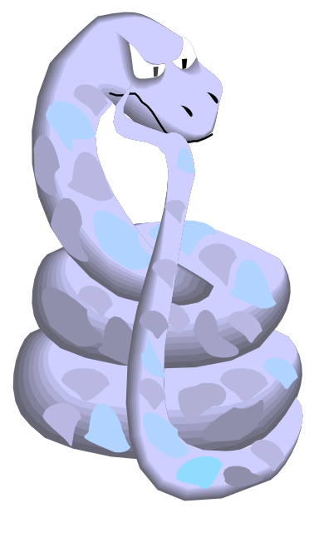
Mutability:
Tuples vs. Lists

Slide 50
Lists are mutable
>>> li = [‘abc’, 23, 4.34, 23]
>>> li[1] = 45
>>> li
[‘abc’, 45, 4.34, 23]
We can change lists in place.
Name li still points to the same memory reference when we’re done.

Slide 51
Tuples are immutable
>>> t = (23, ‘abc’, 4.56, (2,3), ‘def’)
>>> t[2] = 3.14
Traceback (most recent call last):
File "<pyshell#75>", line 1, in -toplevel-
tu[2] = 3.14
TypeError: object doesn't support item assignment
You can’t change a tuple.
You can make a fresh tuple and assign its reference to a previously used name.
>>> t = (23, ‘abc’, 3.14, (2,3), ‘def’)
The immutability of tuples means they’re faster than lists.

Slide 52
Summary: Tuples vs. Lists
Lists slower but more powerful than tuples
  Lists can be modified, and they have lots of handy operations and methods
  Tuples are immutable and have fewer features
To convert between tuples and lists use the list() and tuple() functions:
  li = list(tu)
  tu = tuple(li)

Slide 53
Python Sets
A set is a collection which is both unordered and unindexed.
Sets are written with curly brackets.
Set items are unordered, unchangeable, and do not allow duplicate values.
Example - {"abc", 34, True, 40, "male"}

Slide 54
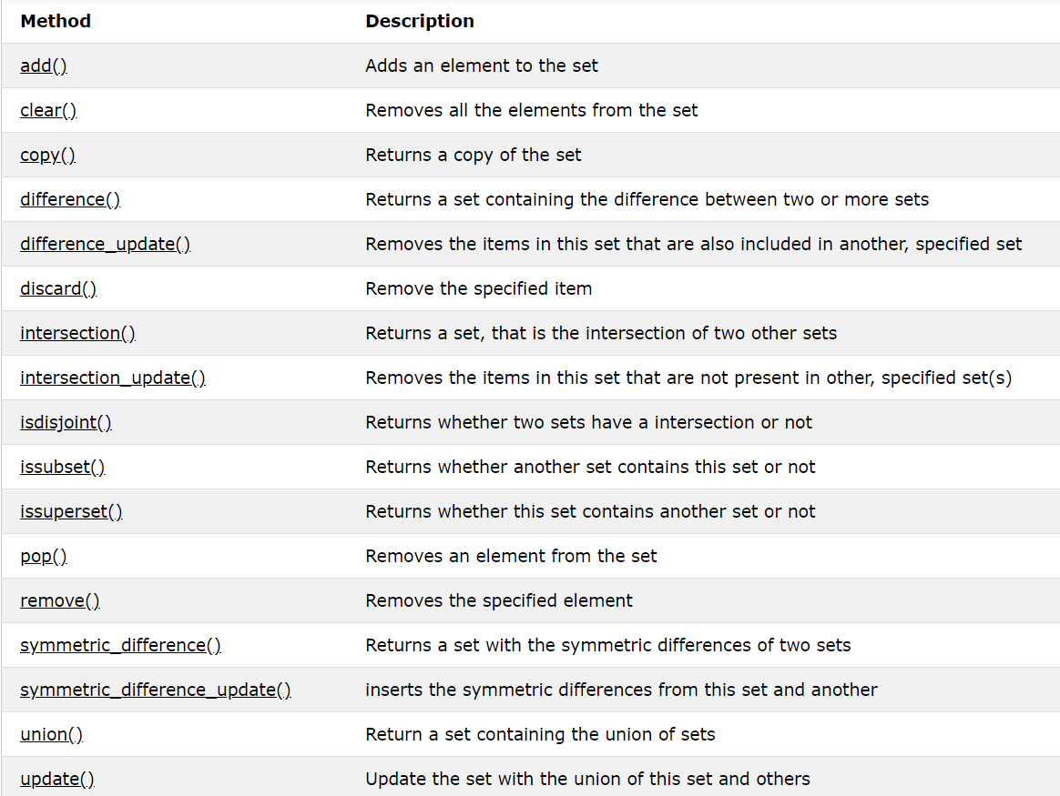
Set Operations

Slide 55
Dictionaries
Dictionaries are used to store data values in key:value pairs.
A dictionary is a collection which is unordered, changeable and does not allow duplicates.
Dictionaries are written with curly brackets, and have keys and values.
Example - {
"brand": "Ford",
"electric": False,
"year": 1964,
"colors": ["red", "white", "blue"]
}

Slide 56
Dictionaries
You can access the items of a dictionary by referring to its key name, inside square brackets.
  thisdict = {
  "brand": "Ford",
  "model": "Mustang",
  "year": 1964
  }
x = thisdict["model"] # “Mustang”
x = thisdict.get("model") # “Mustang”

Slide 57
Dictionary details
Keys must be immutable:
  numbers, strings, tuples of immutables
    these cannot be changed after creation
  reason is hashing (fast lookup technique)
  no restrictions on values
Keys will be listed in arbitrary order
  again, because of hashing

Slide 58
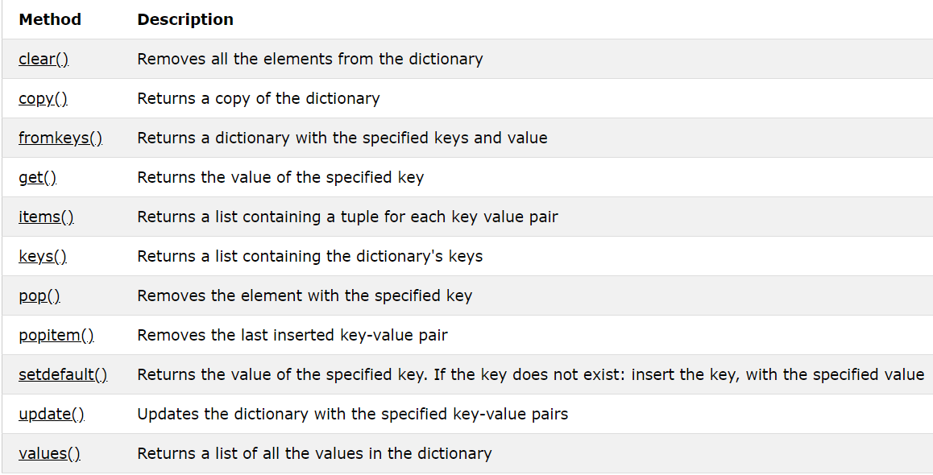
Dictionary Operations

Slide 59
Control Flow

Slide 60
If...elif...else
if, if/else, if/elif/else
if a == 0:
print "zero!"
elif a < 0:
print "negative!"
else:
print "positive!"
Notes:
  blocks delimited by indentation!
  colon (:) used at end of lines containing control flow keywords

Slide 61
While Loop
a = 10
while a > 0:
print(a)
a -= 1
Notes:
  With the break statement we can stop the loop even if the while condition is true
  With the continue statement we can stop the current iteration, and continue with the next

Slide 62
For Loop
A for loop is used for iterating over a sequence (that is either a list, a tuple, a dictionary, a set, or a string).
Example -
fruits = ["apple", "banana", "cherry"]
for x in fruits:
print(x)

Slide 63
Python Functions
In Python a function is defined using the def keyword
Arguments passed by value
All variables are local unless specified as global
def func(x):
y = 10 * x + 2
return y
print(func(10)) # 102

Slide 64
Simple functions: fact.py
"""factorial done recursively and iteratively"""
def fact1(n):
ans = 1
for i in range(2,n):
ans = ans * n
return ans
def fact2(n):
if n < 1:
return 1
else:
return n * fact2(n - 1)

Slide 65
Modules
Modules are functions and variables defined in separate files
Items are imported using from or import
    from module import function
    function()
    import module
    module.function()
You can create an alias when you import a module, by using the as keyword.

Slide 66
Modules
Access other code by importing modules
        import math
        print (math.sqrt(2.0))
      OR
        from math import sqrt
        print (sqrt(2.0))
      OR
        from math import *
        print (sqrt(2.0))

Slide 67
Exceptions
syntax (parsing) errors
while 1 print ('Hello World')
File "<stdin>", line 1
while 1 print 'Hello World'
^
SyntaxError: invalid syntax
exceptions
  run-time errors
  e.g., ZeroDivisionError, NameError, TypeError

Slide 68
Handling exceptions
while 1:
try:
x = int(input("Please enter a number: "))
break
except ValueError:
print "Not a valid number"
First, execute try clause
if no exception, skip except clause
if exception, skip rest of try clause and use except clause
if no matching exception, attempt outer try statement

Slide 69

Introduction to
Speaker: Rishabh Rathi

Slide 70
What is Django?
“Django is a high-level Python web framework that encourages rapid development and clean, pragmatic design.”
The web framework for perfectionists with deadlines.
Free and Open Source.
Primary Focus
  Dynamic and database driven websites
  Content based websites

Slide 71
Why Django?
It’s fast and simple
DRY philosophy — Don’t Repeat Yourself — which means developers can reuse existing code and focus on the unique one.
As a result, it takes a lot less time to get the project to market.
It has one of the best out-of-the-box security systems out there.
With Django, you can tackle projects of any size and capacity, whether it’s a simple website or a high-load web application.
It’s fully loaded with extras and scalable, so you can make applications that handle heavy traffic and large volumes of information
Provides auto generated web admin

Slide 72

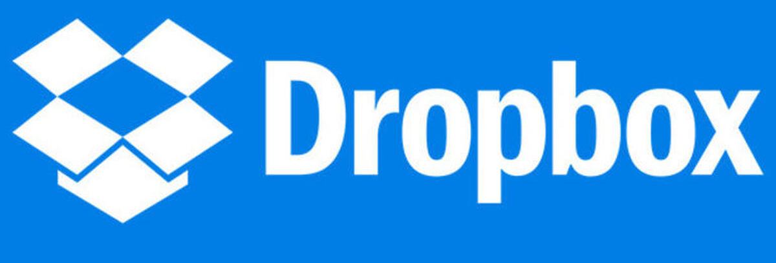




Famous Companies using Django

Slide 73
Virtual Environment
Virtual Environment acts as dependencies to the Python-related projects.
It works as a self-contained container or an isolated environment where all the Python-related packages and the required versions related to a specific project are installed.
Since newer versions of Python, Django, or packages, etc. will roll out, through the help of a Virtual Environment, you can work with older versions that are specific to your project.
In Summary, you can start an independent project related to Django of version 2.0, whereas another independent project related to Django of version 3.0 can be started on the same computer.

Slide 74
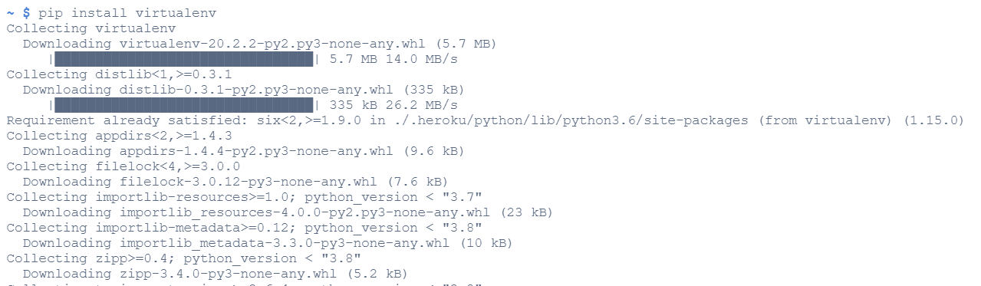
Install Virtual Environment
> pip install virtualenv

Slide 75
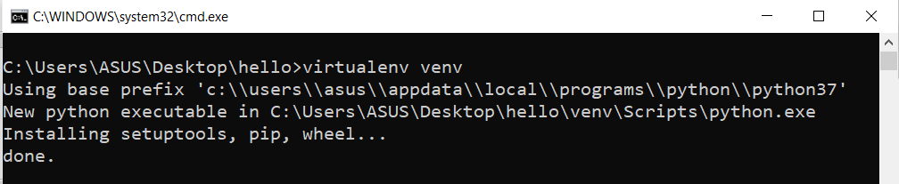
Create Virtual Environment
> virtualenv venv

Slide 76
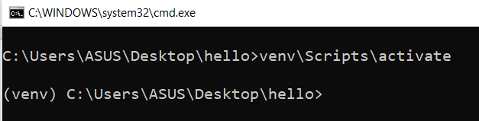
Activate Virtual Environment
> venv\Scripts\activate

Slide 77
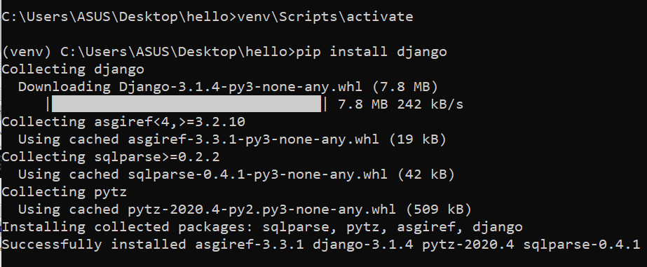
Installing the required package
> pip install django

Slide 78
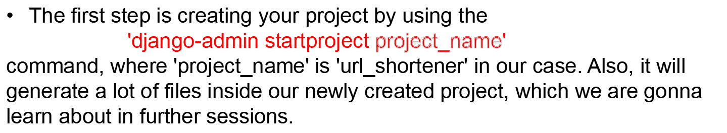
Creating a Django Project
Change the directory to the newly created project using 'cd' command
You can run your project by using 'python manage.py runserver'.

Slide 79
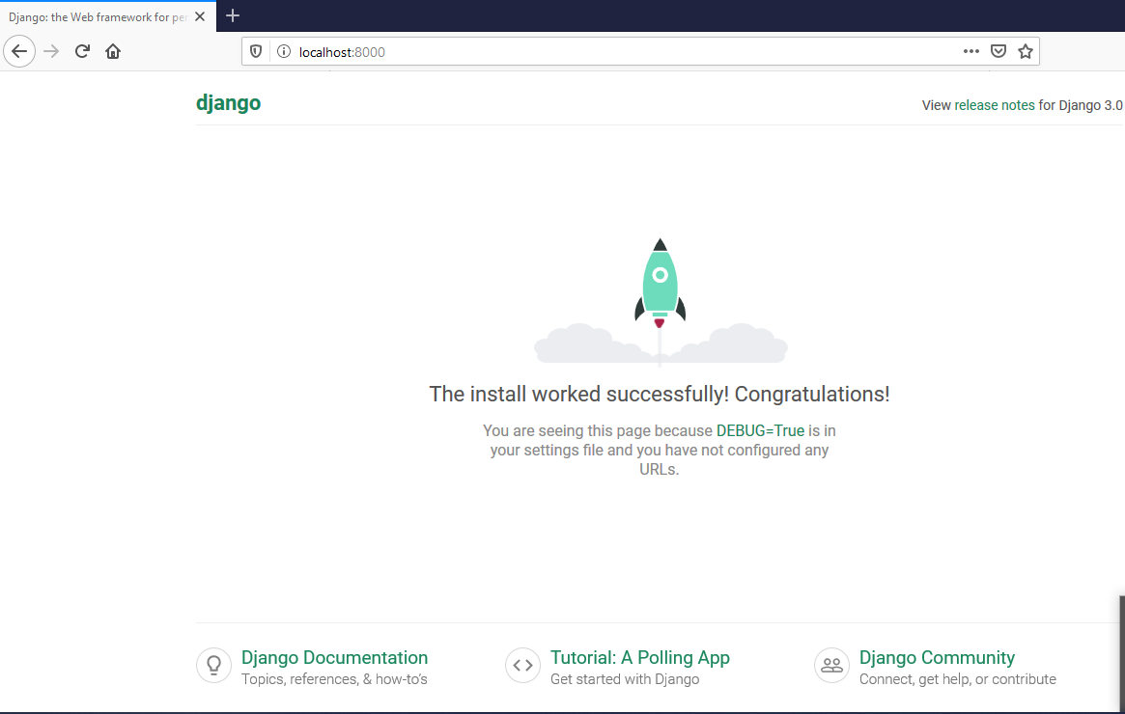
Creating a Django Project (contd.)
The project can be viewed in your favorite browser (Google Chrome, Mozilla Firefox, etc.). You can come into your browser and type 'localhost:8000' or '127.0.0.1:8000' in the URL.

Slide 80
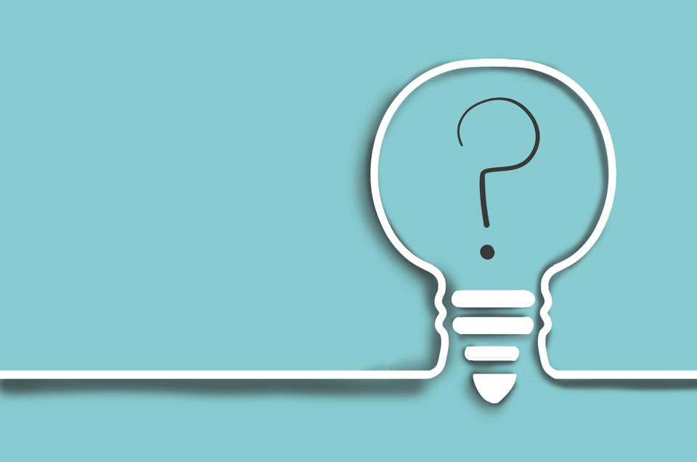
QUESTIONS?
https://bit.ly/django-attendance

